Slide 1
Model-Driven Software Engineering (MDSE) Definition, Core Concepts, and Types of Models

Slide 2
Objectives
Understand the definition and significance of Model-Driven Software Engineering (MDSE).
Explore the core concepts of MDSE.
Learn about different types of models used in MDSE.

Slide 3
Introduction to Model-Driven Software Engineering
MDSE is a software development methodology that focuses on creating and exploiting models as the primary artifacts of software development.
Key Idea:
Shift focus from code-centric development to model-centric development.
Use models to automate parts of the software development lifecycle.
Importance:
Reduces development complexity.
Increases productivity and consistency.
Enables code generation and system analysis.

Slide 4
Core Concepts of MDSE
1)Models as First-Class Citizens:
Models drive the entire development process.
2)Abstraction:
Focus on high-level representations of the system rather than code.
3)Automation:
Code and other artifacts are generated from models using tools.
4)Transformations:
Models are transformed into other models or executable code.
5)Platform Independence:
MDSE supports platform-independent modeling (PIM) and platform-specific modeling (PSM).

Slide 5
Benefits of MDSE
Improved productivity through automation.
Reduces manual errors and increases consistency.
Faster development cycles.
Simplifies system complexity with abstraction.
Supports better communication and understanding among stakeholders.
Enhances reusability of models across different projects.

Slide 6
Types of Models in MDSE
Computation Independent Model (CIM):
Focuses on requirements and the system’s environment.
Abstracts away computational details.
Example: Use case diagrams, business process models.
Platform Independent Model (PIM):
Specifies system functionality and behavior without platform details.
Used to define system logic and structure.
Example: Class diagrams, activity diagrams.
Platform Specific Model (PSM):
Adds platform-specific details to the PIM.
Tailors the model for specific technologies or frameworks.
Example: Database schema diagrams, code annotated for a specific platform.

Slide 7
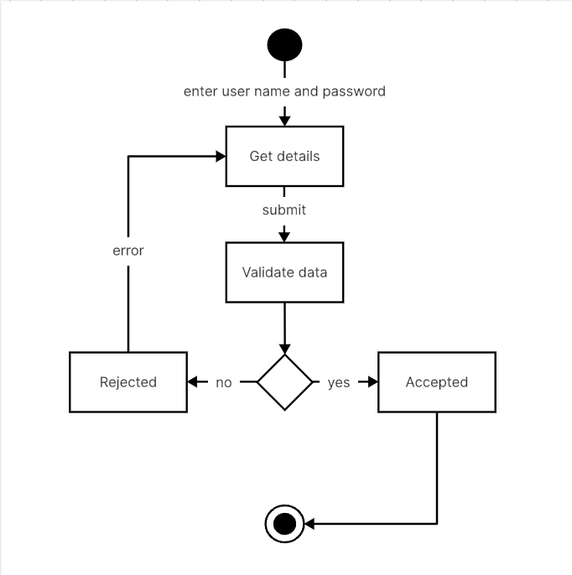
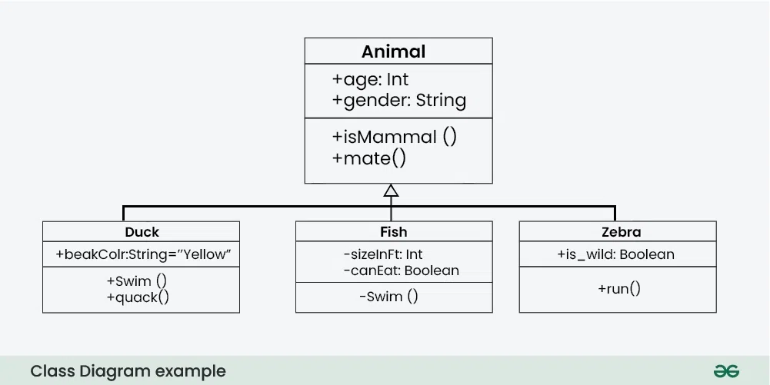
Class diagrams, activity diagrams.

Slide 8
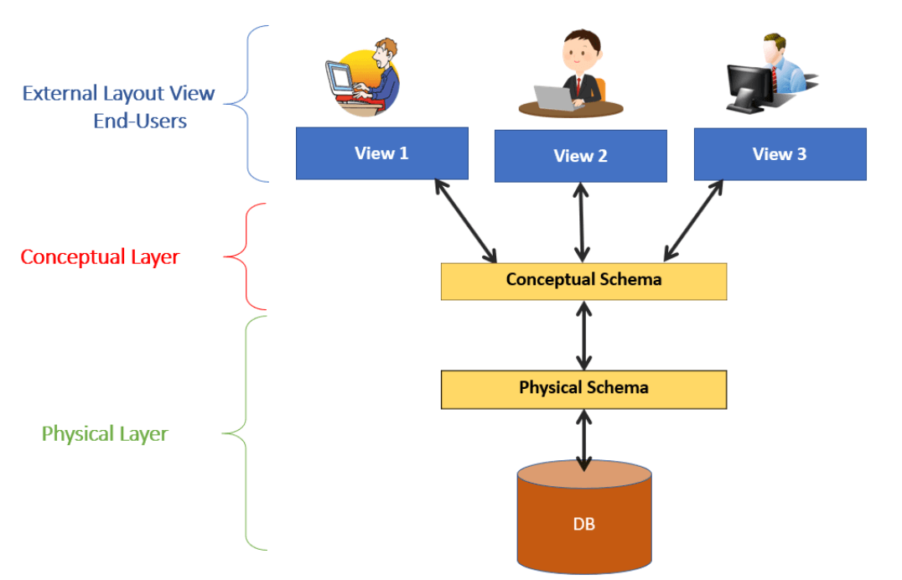
Database schema diagram

Slide 9
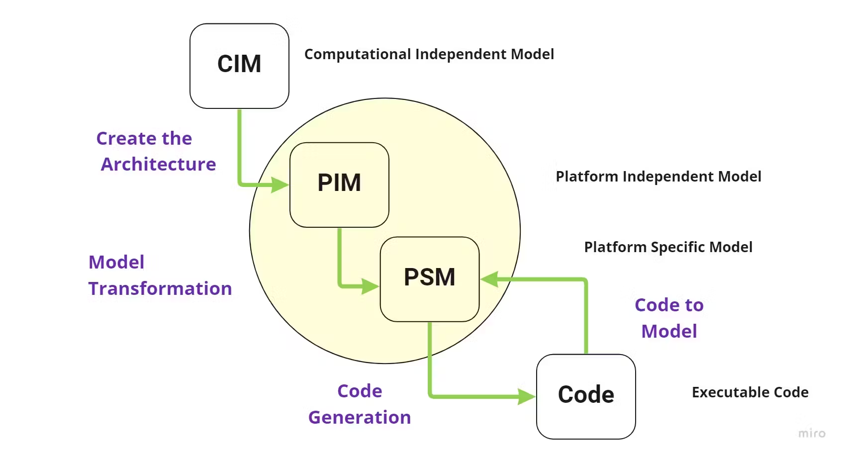

Slide 10
Model Transformations
Process of converting one model into another or generating code.
Types:
Model-to-Model (M2M): Transforming a CIM to PIM, or PIM to PSM.
Model-to-Text (M2T): Generating source code from models.
Tools for Transformation:
Eclipse Modeling Framework (EMF)
ATL (Atlas Transformation Language)
Acceleo for code generation.

Slide 11
Example of MDSE Workflow
Start with a CIM (e.g., use case diagram).
Develop a PIM (e.g., UML class diagram).
Transform the PIM into a PSM (e.g., Java-specific implementation model).
Use tools to generate code from the PSM.

Slide 12
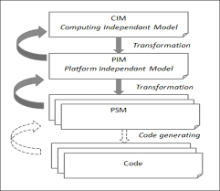

Slide 13
Tools and Technologies for MDSE
Modeling Tools:
Enterprise Architect
IBM Rational Rose
Lucidchart
Code Generation Tools:
Acceleo
Eclipse EMF
Visual Paradigm
Transformation Tools:
ATL
QVT (Query/View/Transformation)

Slide 14
Challenges of MDSE
Steep learning curve for model-driven tools and languages.
High upfront costs for implementing MDSE.
Tool interoperability issues.
Requires a shift in mindset for development teams.
Overhead in maintaining models along with generated artifacts.

Slide 15
Summary
MDSE:
Focuses on using models as primary artifacts in software development.
Core Concepts:
Models, Abstraction, Automation, and Transformations.
Types of Models:
CIM, PIM, and PSM.
MDSE improves productivity, reduces errors, and accelerates development but presents challenges such as learning curve and overhead.

Slide 16
References
Books: “Model-Driven Software Engineering” by Jonas Almström.
Online Resources: TutorialsPoint, GeeksforGeeks.
Tools Documentation: Eclipse EMF, Acceleo, ATL.

